Slide 1


CAPSTONE PROJECT :
THE BATTLE OF NEIGHBORHOODS
IBM Data Science
Professional Certificate
Presentation By: Mahantesh
Date: 31/12/2020

Slide 2
Introduction:
This Project is to help people in exploring better facilities around their neighborhood. It will help people making smart and efficient decision on selecting great neighborhood out of numbers of other neighborhoods in Scarborough, Toronto.
Lots of people are migrating to various states of Canada and needed lots of research for good housing prices and reputed schools for their children. This project is for those people who are looking for better neighborhoods.
This Project aim to create an analysis of features for a people migrating to Scarborough to search a best neighborhood as a comparative analysis between neighborhoods.
The features include median housing price and better school according to ratings, crime rates of that area, road connectivity, weather conditions, good management for emergency, water resources both fresh and wastewater and excrement conveyed in sewers and recreational facilities.
It will help people to get awareness of the area and neighborhood before moving to a new city, state, country or place for their work or to start a new fresh life.

Slide 3
DATA ACQUISITION AND CLEANING:
Data Sources used:
Data Link: https://en.wikipedia.org/wiki/List_of_postal_codes_of_Canada:_M
Data Set: Scarborough dataset scrapped from Wikipedia.
This Dataset consisting of latitude and longitude, zip codes of the Locations.
Foursquare API Data:
The data retrieved from Foursquare contained information of venues within a specified distance
of the longitude and latitude of the postcodes. The information obtained per venue as follows:
Neighborhood
Neighborhood Latitude
Neighborhood Longitude
Venue
Name of the venue e.g. the name of a store or restaurant
Venue Latitude
Venue Longitude
Venue Category

Slide 4
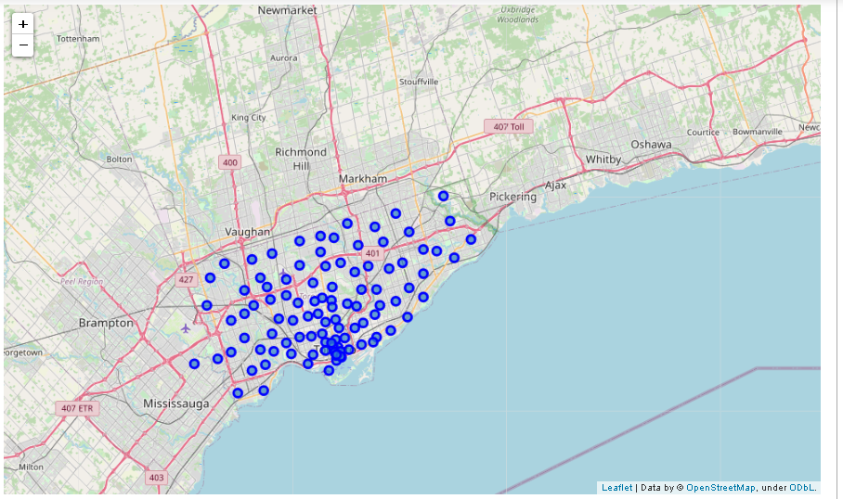
MAP OF SCARBOROUGH:

Slide 5
METHODOLOGY:
Clustering Approach
To compare the similarities of two cities, we decided to explore neighborhoods, segment them, and group them into clusters to find similar neighborhoods in a big city like New York and Toronto.
To be able to do that, we need to cluster data which is a form of unsupervised machine learning: k-means clustering algorithm.

Slide 6
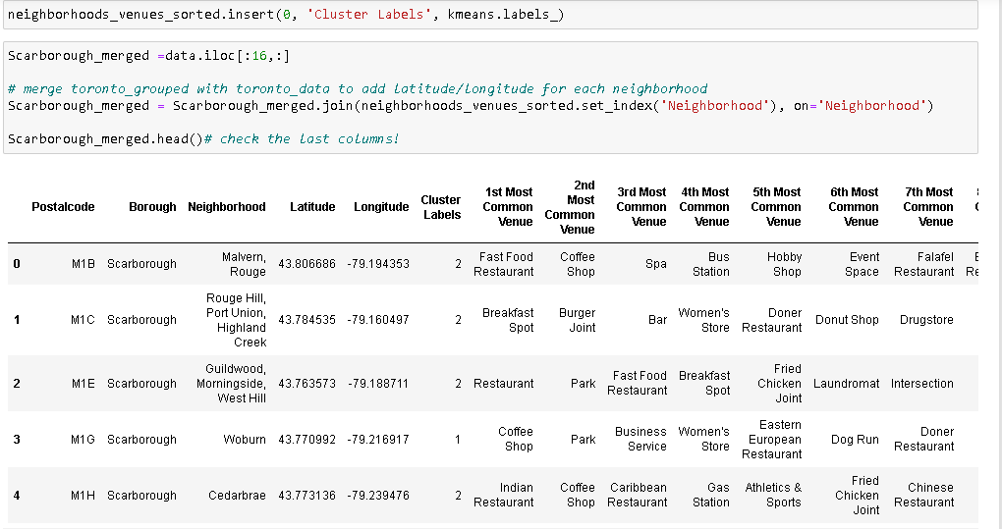
METHODOLOGY Cont..
K-Means Clustering Approach:

Slide 7
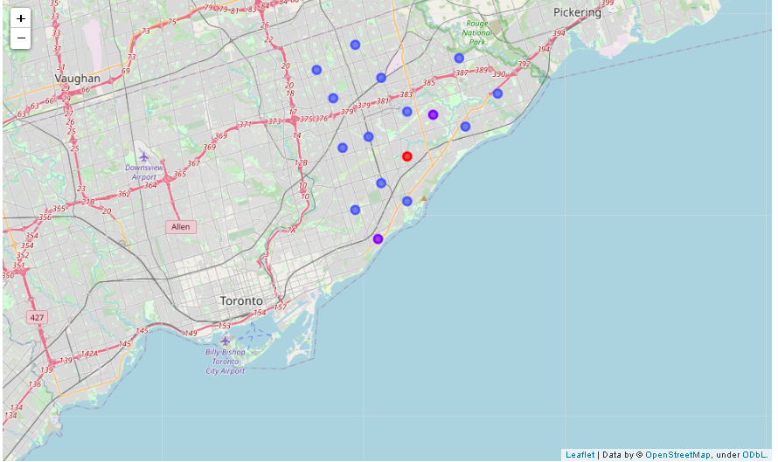
EXPLORATORY DATA ANALYSIS
Map of Clusters in
Scarborough

Slide 8
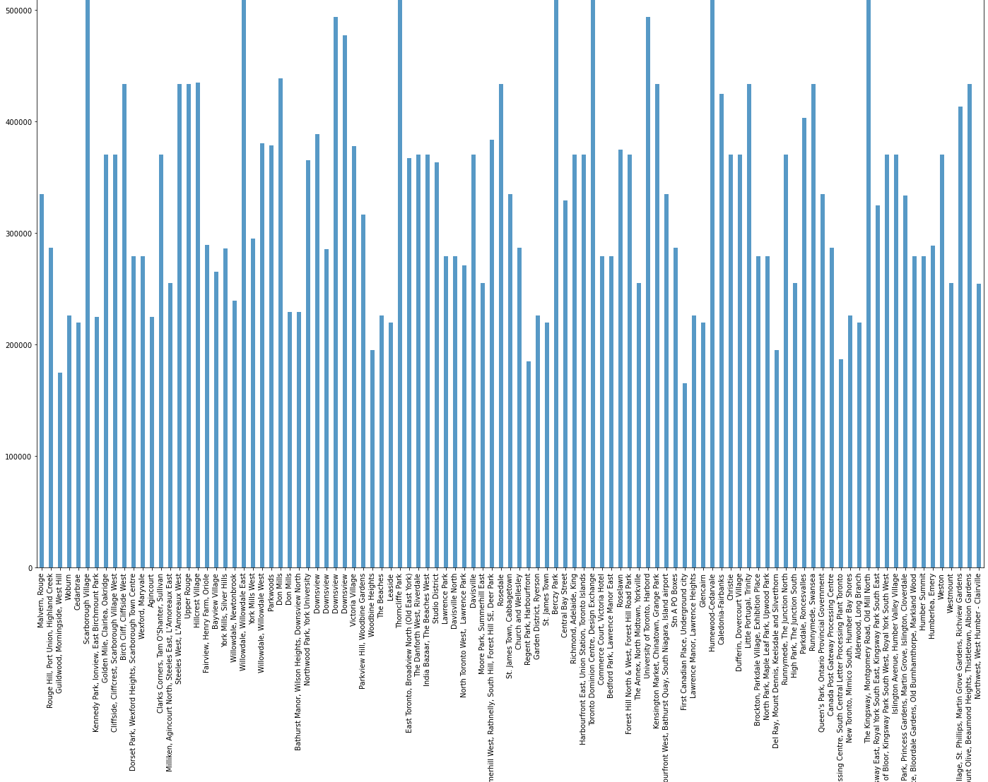
AVERAGE HOUSING PRICE BY CLUSTERS IN SCARBOROUGH
EXPLORATORY DATA ANALYSIS
Cont..

Slide 9

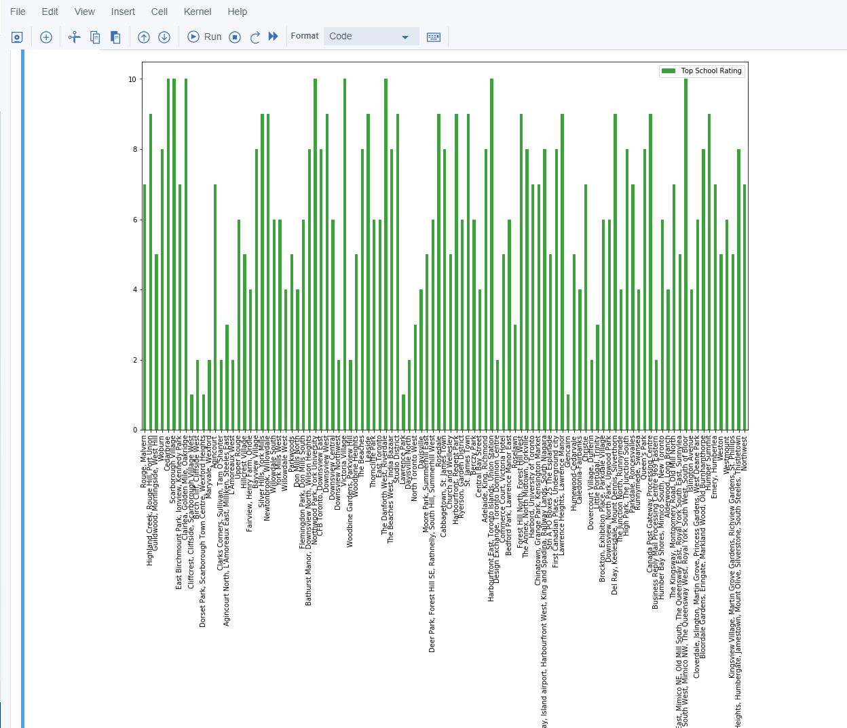

School Ratings by Clusters in Scarborough

Slide 10
CONCLUSION:
In this project, using k-means cluster algorithm we separated the neighborhood into 10(Ten) different clusters and for 103 different latitude and longitude from dataset, which have very-similar neighborhoods around them.
Using the charts above results presented to a particular neighborhood based on average house prices and school rating have been made.
This project has shown me a practical application to resolve a real situation that has impacting personal and financial impact using Data Science tools.
The mapping with Folium is a very powerful technique to consolidate information and make the analysis and decision better with confidence.

